Slide 1




Slide 2
BY
REAL TIME PCR ………A step forward in medicine
Dr. Naglaa Ibrahim Azab
Assistant Professor of Medical Biochemistry
Faculty Of Medicine –Benha University

Slide 3
Nomenclature commonly used in real time quantitative RT-PCR

Slide 4
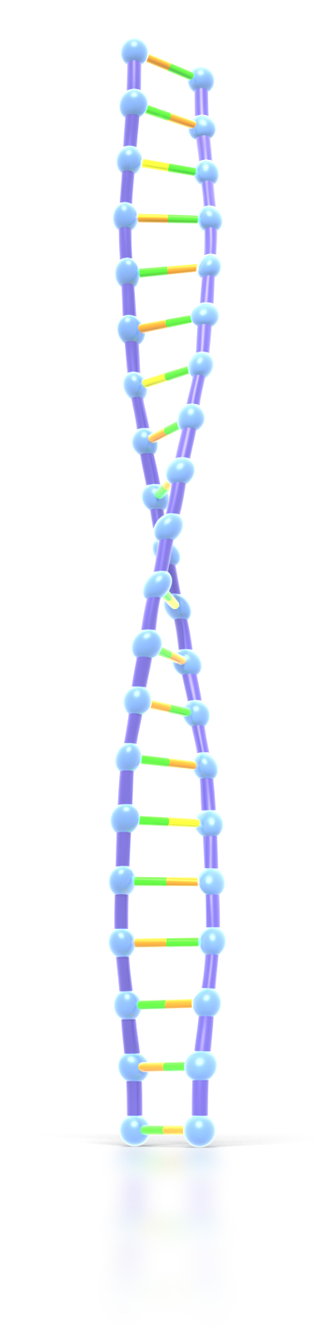
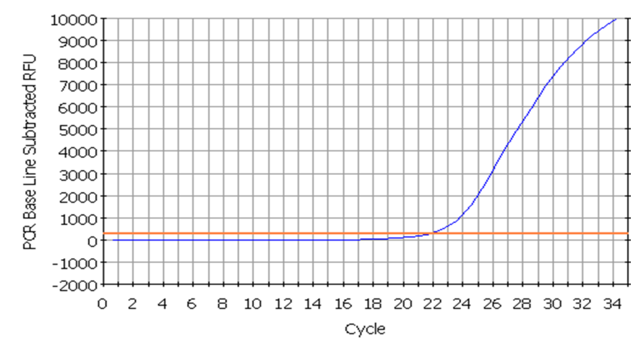
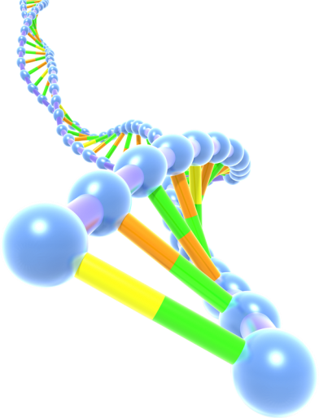
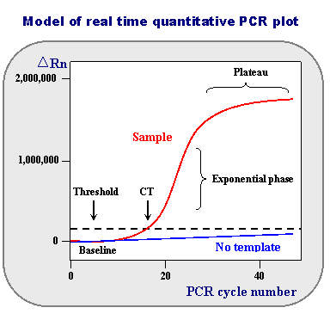
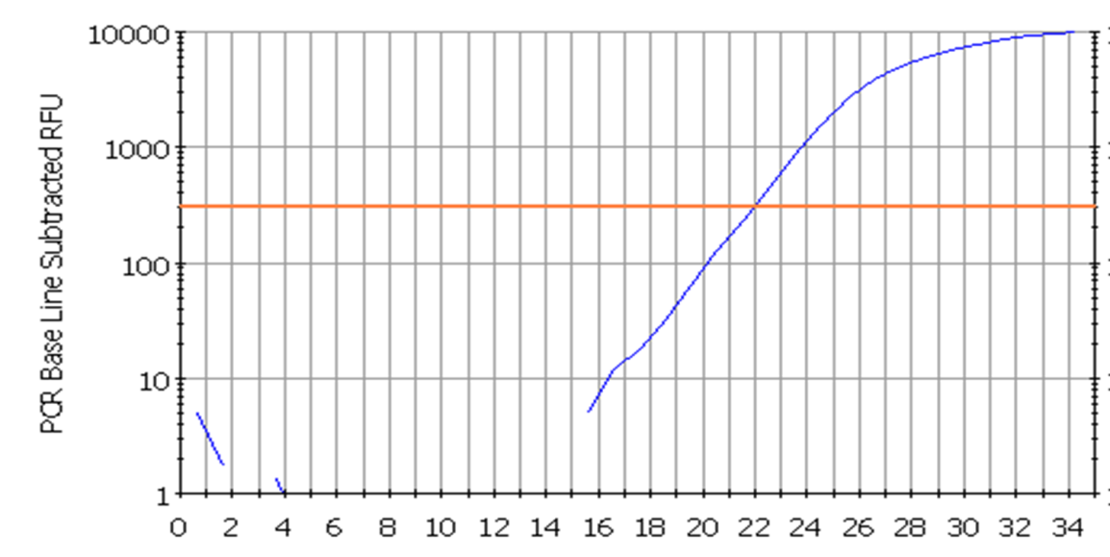
Amplification plot: is the graphical display of the fluorescence signal (linear or log) versus cycle number
ΔRn: is an increment of fluorescent signal at each time point. The ΔRn values are plotted versus the cycle number.

Slide 5
Baseline : is the early (initial) PCR cycles in which a reporter fluorescent signal is accumulating but is beneath the limits of detection of the instrument. It typically measured between cycles 3 and 15, where there is no detectable increase in fluorescence due to amplification products.

Slide 6
Threshold is the level of Δrn in the exponential phase of amplification that is set above the base line either manually or automatically
.
It is a level of fluorescence chosen on the basis of the baseline variability
A signal that is detected above the threshold is considered a real signal that can be used to define the threshold cycle (Ct) for a sample.
Threshold can be adjusted for each experiment so that it is in the region of exponential amplification across all plots.
Ct is the fractional PCR cycle number at which the reporter fluorescence is greater than the threshold. i.e at which there is significant detectable increase in fluorescence

Slide 7
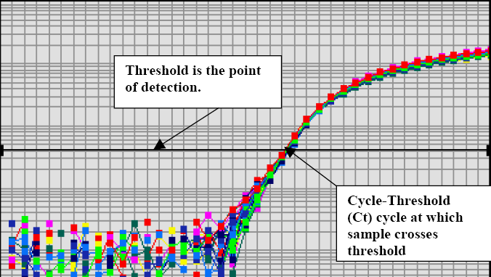
Ct (threshold cycle): The fractional cycle number at which the fluorescence passes the fixed threshold NTC
(no template control) - A sample that does not contain template. It is used to verify amplification quality

Slide 8
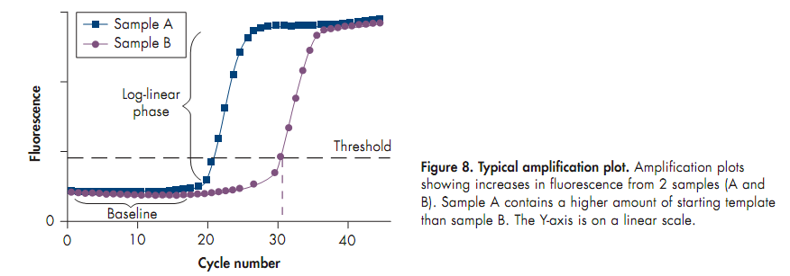
CT serves as a tool for calculation of starting template amount in each sample. The higher the starting copy number of the nucleic acid target, the sooner a significant increase in fluorescence is observed. (lower cycle threshold)

Slide 9
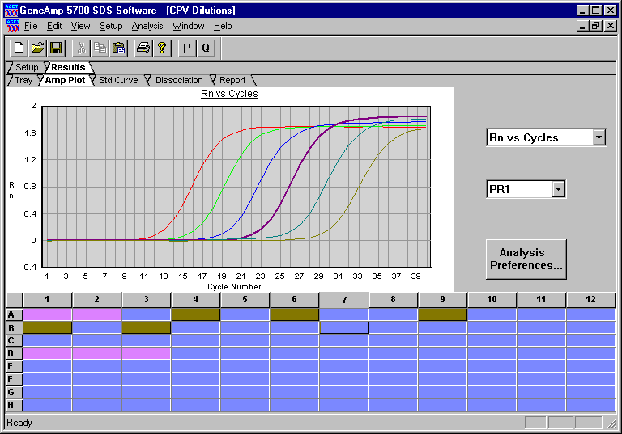
From PCR to Real-Time PCR
End Point
Real-Time
Amplification plot: The plot of fluorescence signal (ΔRn)
( (NUMBER OF AMPLIFIED PRODUCTS)versus cycle number

Slide 10
ΔCT value: is the difference between the CT value of the target gene and the CT value of the corresponding endogenous reference gene, such as a housekeeping gene,
ΔCT = CT (target gene) – CT (endogenous reference gene)
Endogenous reference gene: This is a gene whose expression level should not differ between samples, such as a housekeeping gene. As b- actin gene
Comparing the CT value of a target gene with that of the endogenous reference gene allows normalization of the expression level of the target gene to the amount of input RNA or cDNA (normalize for the amount of template used ). The exact amount of template in the reaction is not determined.
An endogenous reference gene corrects for possible RNA degradation or presence of inhibitors in the RNA sample, and for variation in RNA content, reverse-transcription efficiency,nucleic acid recovery, and sample handling.

Slide 11
ΔΔCT value: The ΔΔCT value describes the difference between the average ΔCT value of the sample
of interest (e.g., stimulated cells) and the average ΔCT value of a reference sample (e.g., unstimulated
cells). The reference sample is also known as the calibrator sample and all other samples will be
normalized to this when performing relative quantification:
ΔΔCT = average ΔCT (sample of interest) – average ΔCT (reference sample)

Slide 12
Quantification using real time PCR can be either relative or absolute:

Slide 13
What is Absolute Quantitation?
It determines expression levels of target gene in absolute numbers of copies.
is used to quantitate unknown samples by interpolating their quantity from a standard curve.
The standard is nucleic acid molecules of known copy number or concentration in addition to the following features:
primer & probe binding sites identical to the target to be quantified
Sequence between the primer binding sites identical or highly similar to the target sequence .
Sequences upstream &downstream from the amplified sequence identical or similar to natural agent.
Equivalent amplification effieciencies of standard or target molecules

Slide 14
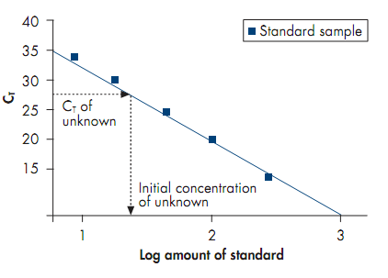
What is Absolute Quantitation?
Standard curve is formed of a plot of Ct values of different standard dilutions against log conc of standard

Slide 15
What is relative quantitation?
It describes the change in the expression of a target gene in a test sample relative to a calibrator sample.
Here we calculate gene expression levels by determining the ratio between the amount of target gene and endogenous reference gene in all samples & then this ratio is compared between different samples
This reference gene is often a housekeeping gene and can be co-amplified in the same tube in a multiplex assay or can be amplified in a separate tube..

Slide 16
Relative quantitation can be done by any of these methods:
1-Relative standard curve method
2-Comparative ct or ΔΔCt method

Slide 17
Relative standard curve method:
Dilutions of the stock DNA or RNA is done.
Standard curves are prepared for both the target gene and endogenous control.(Amount versus Ct)
For each sample, the amount of target & endogenous control is determined from the corresponding standard curve.
Normalized target value =
Relative expression levels =
Target gene expression(amount)
endogenous control gene expression
Normalized target value
Normalized calibrator value

Slide 18
Comparative or ΔΔCt method for relative quantitation: This method assumes that the amplification efficiencies of the gene of interest and the housekeeping genes are close to 100 percent (meaning a standard or calibration curve slope of -3.32).
The Ct values obtained from two different experimental RNA samples are directly normalized to a housekeeping gene and then compared.
ΔCT = CT (target gene) – CT (endogenous reference gene)

Slide 19
Comparative or ΔΔCt method for relative quantitation: First, the difference between the Ct values (ΔCt) of the gene of interest and the housekeeping gene is calculated for each experimental sample. Then, the difference in the ΔCt values between the experimental and control samples ΔΔCt is calculated.
ΔΔCT = average ΔCT (sample of interest) – average ΔCT (reference sample or calibrator sample)
The fold-change in expression of the gene of interest between the two samples is then equal to 2^(-ΔΔCt).

Slide 20
Real-Time PCR Applications

Slide 21
Quantitation of gene expression
Pathogen detection (including CMV detection, rapid diagnosis of meningococcal infection, penicillin susceptibility of Streptococcus pneumoniae ,Mycobacterium tuberculosis and its resistant strains and waterborne microbial pathogens in the environment
Pathogen quantitation (Absolute Quantitation)
Array verification
Drug therapy efficacy / drug monitoring
Mitochondrial DNA studies
Quality control and assay validation

Slide 22
Methylation detection
RNA interference studies
Determination of identity at highly polymorphic HLA loci
Genotyping
Quantitative microsatellite analysis
quantitative allelic discrimination
Prenatal diagnosis / sex determination using single cell isolated from maternal blood
Prenatal diagnosis of hemoglobinopathies
Intraoperative cancer diagnostics
Linear-after-the-exponential (LATE)-PCR: a new method for real-time quantitative analysis of target numbers in small samples, which is adaptable to high throughput applications in clinical diagnostics, bio-defense, forensics, and DNA sequencing

Slide 23

THANK
YOU

